Slide 1
Building Blocks: Basics of Scientific Writing
Shannon Smith
CPBP 8324
17 February 2021

Slide 2
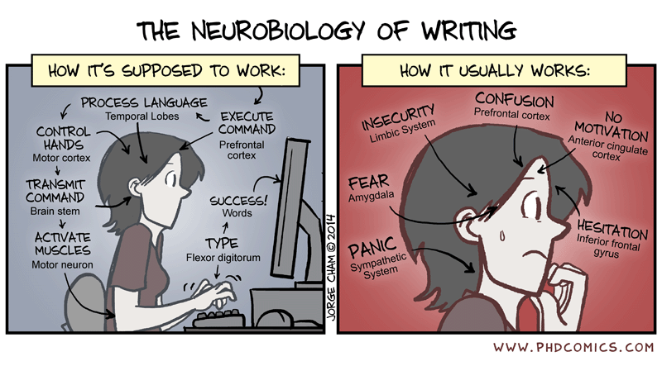
Goals for this session:
Make the writing process less daunting
Universal basics of scientific writing
Guidelines for research articles and grant proposals
Understand what makes good figures.
Big-picture and technical guidelines to follow.
*Schimel, J. 2012, Writing science: How to write papers that get cited and proposals that get funded.

Slide 3
We’re scientists, not writers. Why does this matter?
“As a scientist, you are a professional writer: your career is built on successful proposals and papers*.”
“Publish or perish.”
“In science, the credit goes to the man who convinces the world, not the man to whom the idea first occurs.” – Sir William Osler
What good is your work if it isn’t shared?
*Schimel, J. 2012, Writing science: How to write papers that get cited and proposals that get funded.

Slide 4
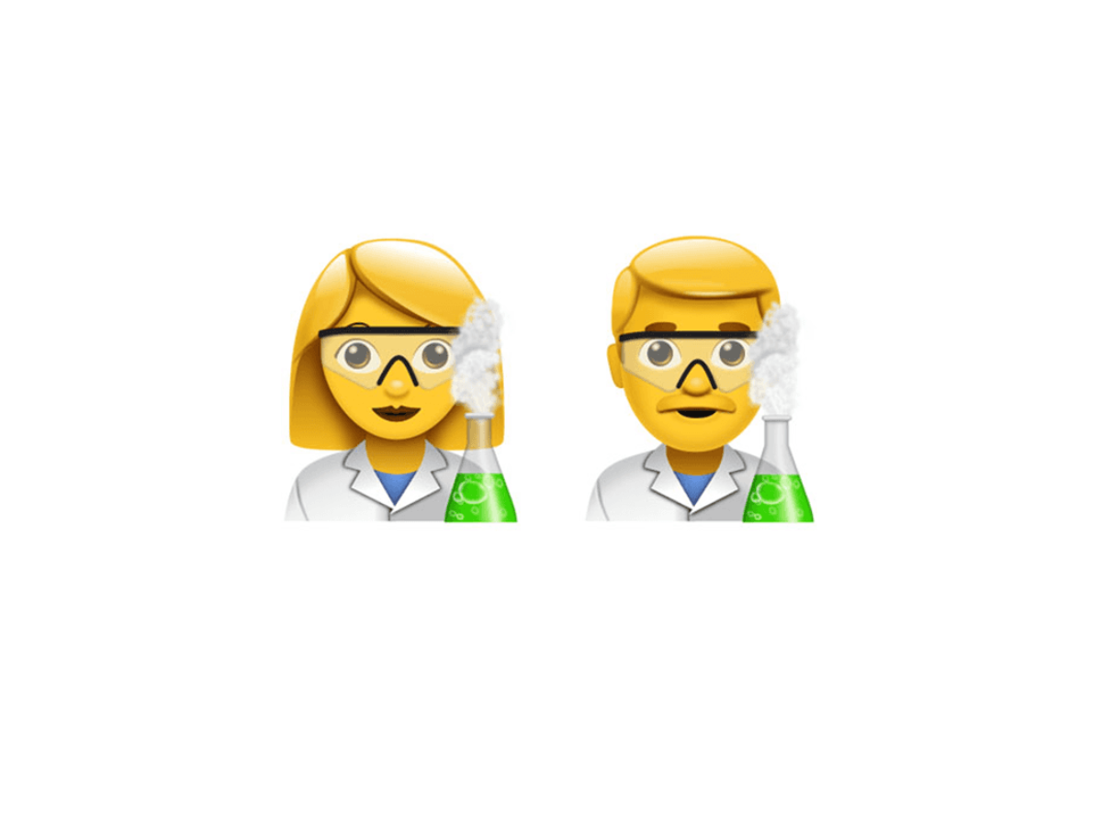


Writing is how you contribute to science
Research publications
Grant applications
Patents
Press releases
Newspapers, magazines
Social media post

Slide 5
You have a lot of experience already
How often do you read scientific literature?
Tell me some things that you like and don’t like to see when reading research articles.
How often do you write? Daily? Weekly? Monthly?
(You really should write everyday.)
What are your experiences in scientific writing? What is your typical workflow?

Slide 6
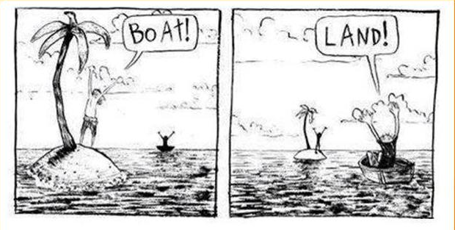
The Perspective You Use to View Writing
Any writing is an exchange between an author and their audience
Author’s goal: have the readers/reviewers see the importance of their data from a set perspective
Reader’s goal: Learn new science from the article to improve their own work/knowledge
Think about how information is presented/how it will be interpreted by audience
Think about perspective
“If the reader is to grasp what
the writer means, the writer must
understand what the reader needs.”*
*The Science of Scientific Writing – George Gopen, American Scientist

Slide 7
As a fellow scientist, why do you read research publications?
From the reader’s perspective:
What is the major finding?
Is this finding supported by the data?
How does this relate to my own work?
What is the broader effect on the field?
Research publications
Fellow researchers in your field, collaborators, etc.

Slide 8
Committee members: what do they look for?
From the reader’s perspective:
Does the author have a clear goal?
Is the proposal realistic?
Is the science sound and based in evidence?
Are the preliminary results supported by data?
Do the ideas expand and improve the field as a whole?
Grant applications
Patents
A diverse panel of scientists, policy makers
Unlikely in your field

Slide 9
Why would the general public read about science?
From the reader’s perspective:
Want expert knowledge on a topic
What is this person talking about?
What is the major take-away point?
What is the evidence?
What does this research mean for society?
Press releases
Newspapers, magazines
Social media post
Non-scientists

Slide 10

Make reading as easy as possible
Reading science takes energy
Structure versus substance
Structure: What is the author trying to say?
Substance: Does the science make sense?
Make sure the reader spends a little energy as possible on figuring out what you’re trying to say
How do you emphasize important points? How does the reader know which points you’re emphasizing?
Structure
Substance
Clarity
Conciseness

Slide 11
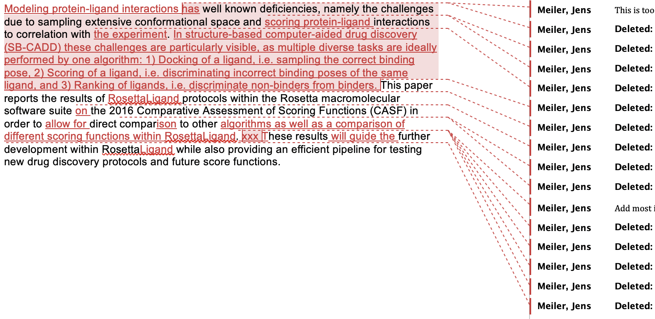
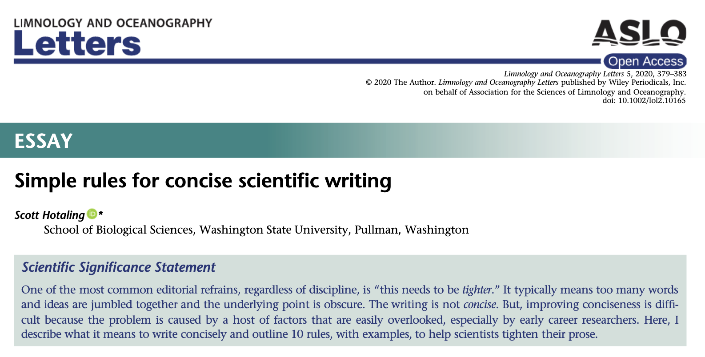
Universal rule of scientific writing: be clear and concise.

Slide 12
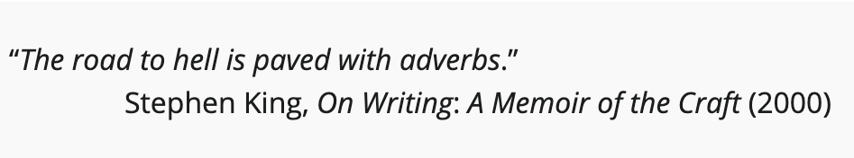
Concise words and sentences
Avoid unnecessary “lead-ins”.
“If you find yourself swimming in the ocean, be wary of sharks.”
“Be wary of sharks when swimming in the ocean.” [3 words saved]
“In a recent study, Smith et al. (2015) showed that giraffes are larger than squirrels.”
“Giraffes are larger than squirrels (Smith et al., 2015).“ [6 words saved]
“In Figure 1, we show that testosterone levels were higher in birds than fish.”
“Testosterone levels were higher in birds than fish (Figure 1).” [4 words saved]
Remove unnecessary words.
Almost all “–ly” words can be deleted.
Condense multi-word phrases.
“In order to” → “To”, “As well as” → “and”, ”was found to be” → “was”, etc.
Transition words and combine sentences where possible
“Moreover, we show that sharks are larger than otters, Thus, sharks should be considered in global management plans. Finally, sharks are also faster swimmers than otters.”
“We show that sharks are larger than otters and should be considered in global management plans. Sharks also swim faster than otters.

Slide 13
Concise words and sentences
Simplify language
E.g. “utilize” or “leverage” → “use”, ”frequently” or “typically” → “often”
You can usually use personal pronouns (check with journal)
Using these can shorten sentences and make reading more straight-forward
“XYZ was performed.” → “We did XYZ.”
Avoid jargon and acronyms as much as possible
Remember who is reading this—is this a common word they would know?
Unless it’s a highly-used acronym (gene/protein name you’re studying), DNA
If using an acronym, write the full name only once

Slide 14
Review your assignment
Review the sentence you wrote before class
Prompt: Write a single sentence that describes the overall objective of your proposed thesis.
Is the purpose stated clearly and directly?
Do you include filler words anywhere?

Slide 15
Paragraphs should clearly define a single point
What is the major point of this paragraph?
Your first sentence is your topic sentence and needs to state this
A common strategy: for each paragraph, make the first sentence a subtitle
The rest of the paragraph provides the necessary information to support the first sentence

Slide 16
Paragraphs
The smallest of the URF's (URFA6L), a 207-nucleotide (nt) reading frame overlapping out of phase the NH₂-terminal portion of the adenosinetriphosphatase (ATPase) subunit 6 gene has been identified as the animal equivalent of the recently discovered yeast H⁺-ATPase subunit 8 gene. The functional significance of the other URF's has been, on the contrary, elusive. Recently, however, immunoprecipitation experiments with antibodies to purified, rotenone-sensitive NADH-ubiquinone oxido-reductase [hereafter referred to as respiratory chain NADH dehydrogenase or complex I] from bovine heart, as well as enzyme fractionation studies, have indicated that six human URF's (that is, URF1, URF2, URF3, URF4, URF4L, and URF5, hereafter referred to as ND1, ND2, ND3, ND4, ND4L, and ND5) encode subunits of complex I. This is a large complex that also contains many subunits synthesized in the cytoplasm.*

Slide 17
Paragraphs
The smallest of the URF's (URFA6L), a 207-nucleotide (nt) reading frame overlapping out of phase the NH₂-terminal portion of the adenosinetriphosphatase (ATPase) subunit 6 gene has been identified as the animal equivalent of the recently discovered yeast H⁺-ATPase subunit 8 gene.
In writing, verbs are expected to immediately follow their subject
~20 words separate the subject and verb, leading the sentence to drag on…
When not carefully used, large gaps between subjects and actions can create confusion in the reader
How can this problem be fixed?

Slide 18
Paragraphs should clearly define a single point
Review the paragraphs you wrote prior to class
What is the major point of this paragraph?
Did I explicitly state this anywhere?
This should be the first sentence

Slide 19
Questions you should answer before you begin writing:
**What is the goal?
Declare an endpoint (or you will never publish anything!)
Optimizing a new method? Decide beforehand when that optimization is good enough to publish.
New drug candidate? Decide beforehand on number of tested compounds/affinity goal.
A paper should be focused on telling one story
Decide on the single take-home message
Trying to do too much leads to confusion and it’s tough to write
What am I writing?
Research article, grant application, magazine, newspaper, press release, etc.
Who will be reading?
Experts in my field, NIH reviewer, general scientific audience, non-scientific audience

Slide 20
Questions you should answer before you begin writing:
Who are the authors? Who is first/last author?
Each author should know their role ahead of time
5. Where am I submitting?
This can help with defining the goal
Provides a built-in outline, formatting rules
6. Decide on the data that will be included
What is the purpose of these data?
Are these data necessary to support conclusion(s)? You do not need to report every piece of data.
Common strategy: Outline order of data figures first then begin writing.

Slide 21
PIs have a lot of experience with writing; here are some of their strategies
Write now, edit later. AKA just get words on paper.
Write a detailed outline using sections specified straight from the journal’s requirements; each point then becomes the first sentence of each paragraph
Have a heading at beginning of each paragraph describing the major finding in the following paragraph. If journal doesn’t allow this, then just move it to first sentence of paragraph.
Start with determining the figures, then build the paper around them.

Slide 22
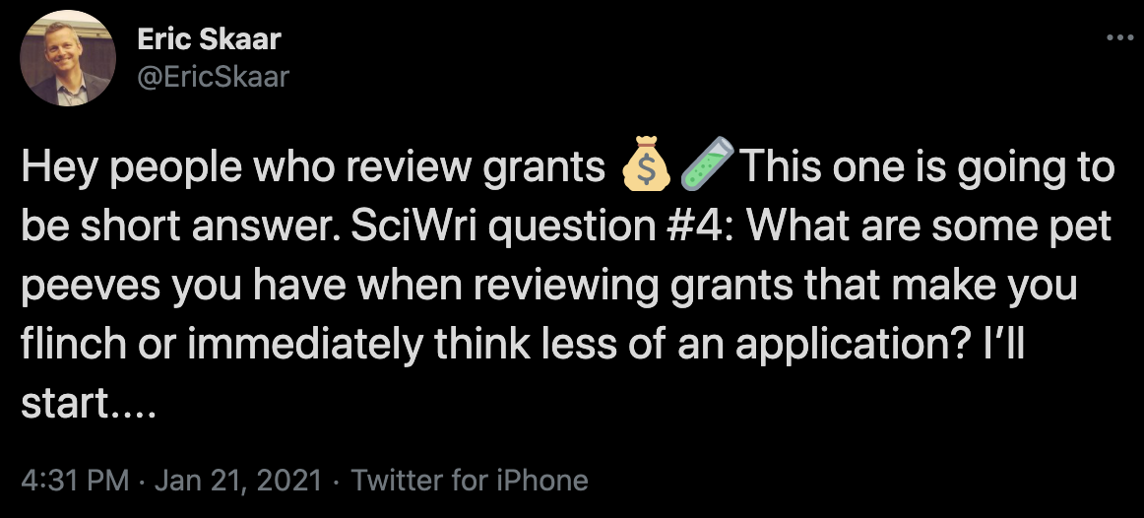
What do grant reviewers look for?
https://twitter.com/EricSkaar/status/1352383459080118272
(If you replace “grants” with “publications”, most of these still apply.)
Go to this tweet thread, select 2 points made here that you are guilty of or want to discuss, comment in the chat.

Slide 23
Figures are as important as the writing in research papers (just my opinion)
First thing readers see—make a good first impression
Figures should stand on their own!
Don’t spend too much time perfecting an image. The editor can also tell you if they want it changed.
Adapted from Rougier NP, Droettboom M, Bourne PE (2014) Ten Simple Rules for Better Figures. PLOS Computational Biology 10(9): e1003833. https://doi.org/10.1371/journal.pcbi.1003833

Slide 24
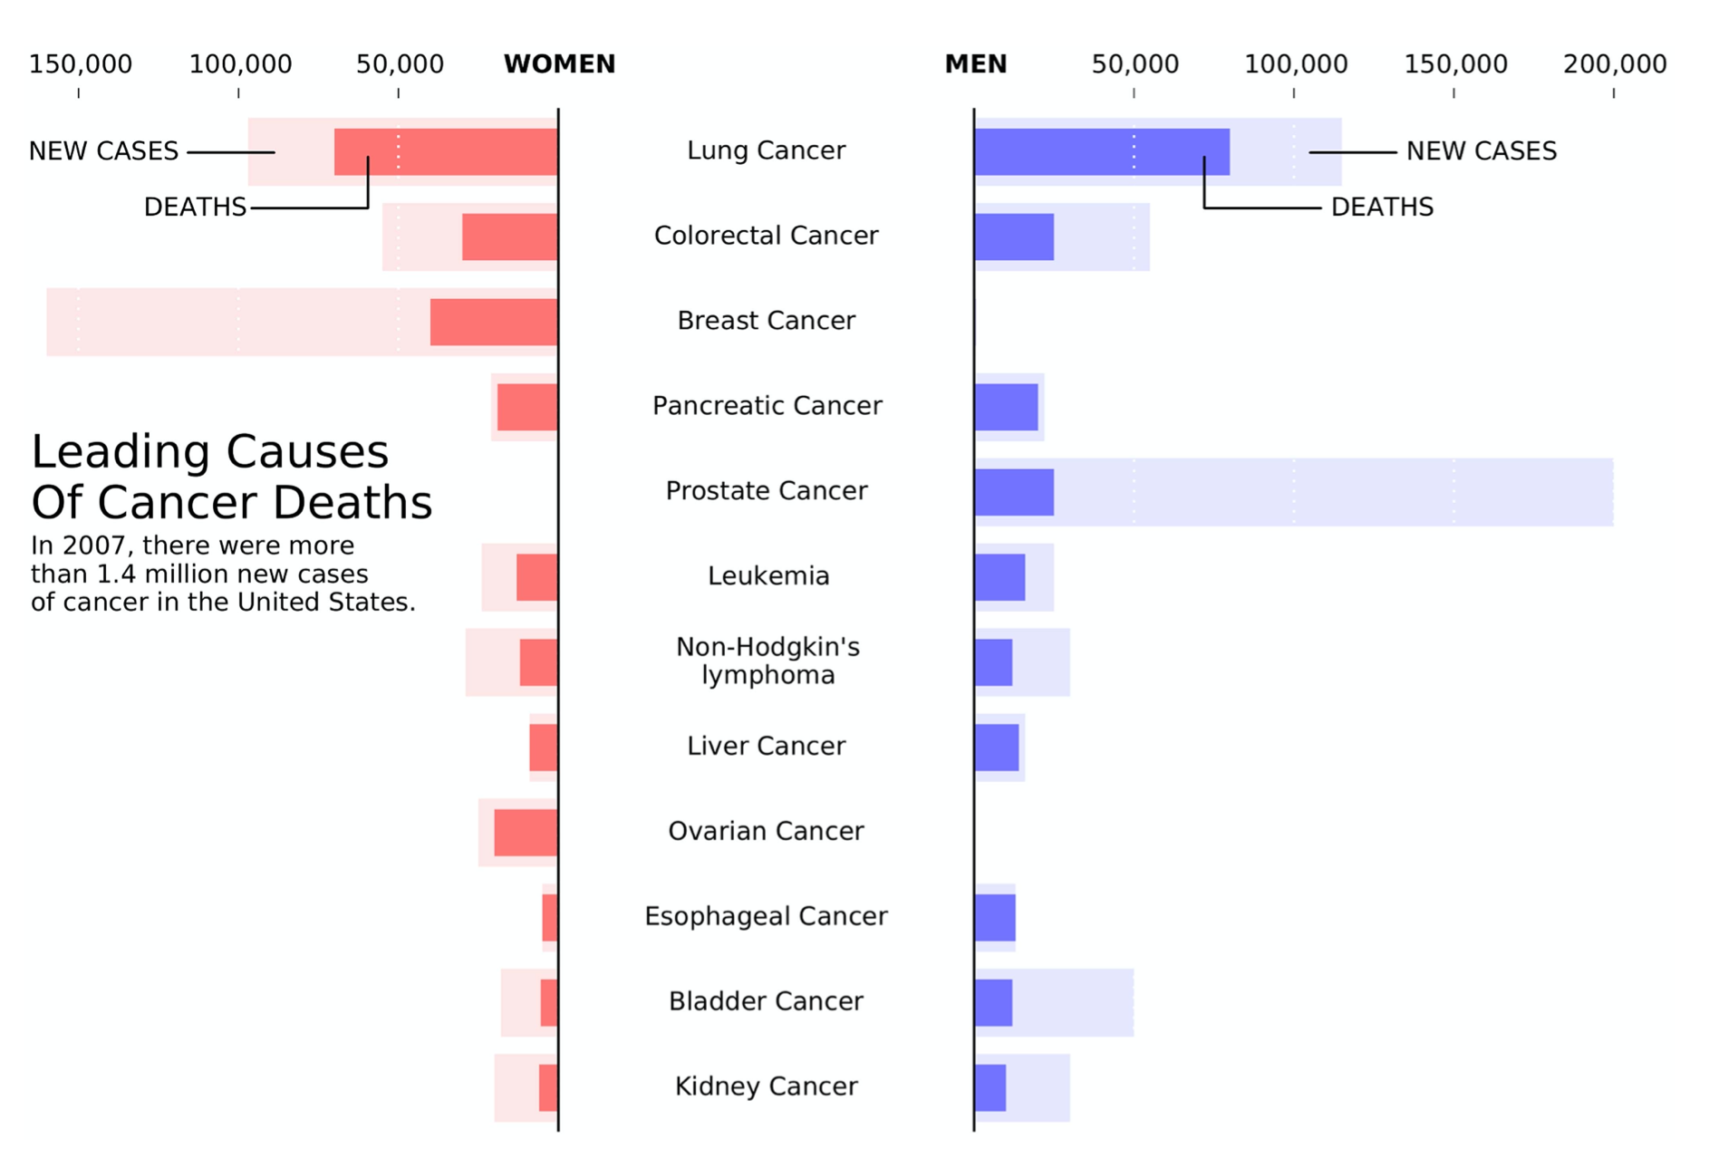
Know your audience
Decide on the message
What is the primary purpose of this figure?
Comparing death rates of different cancer types
Men vs. women
New cases vs. deaths
Know your audience
Where do you think this this figure was published?
New York Times
How would you change this for a scientific audience?

Slide 25
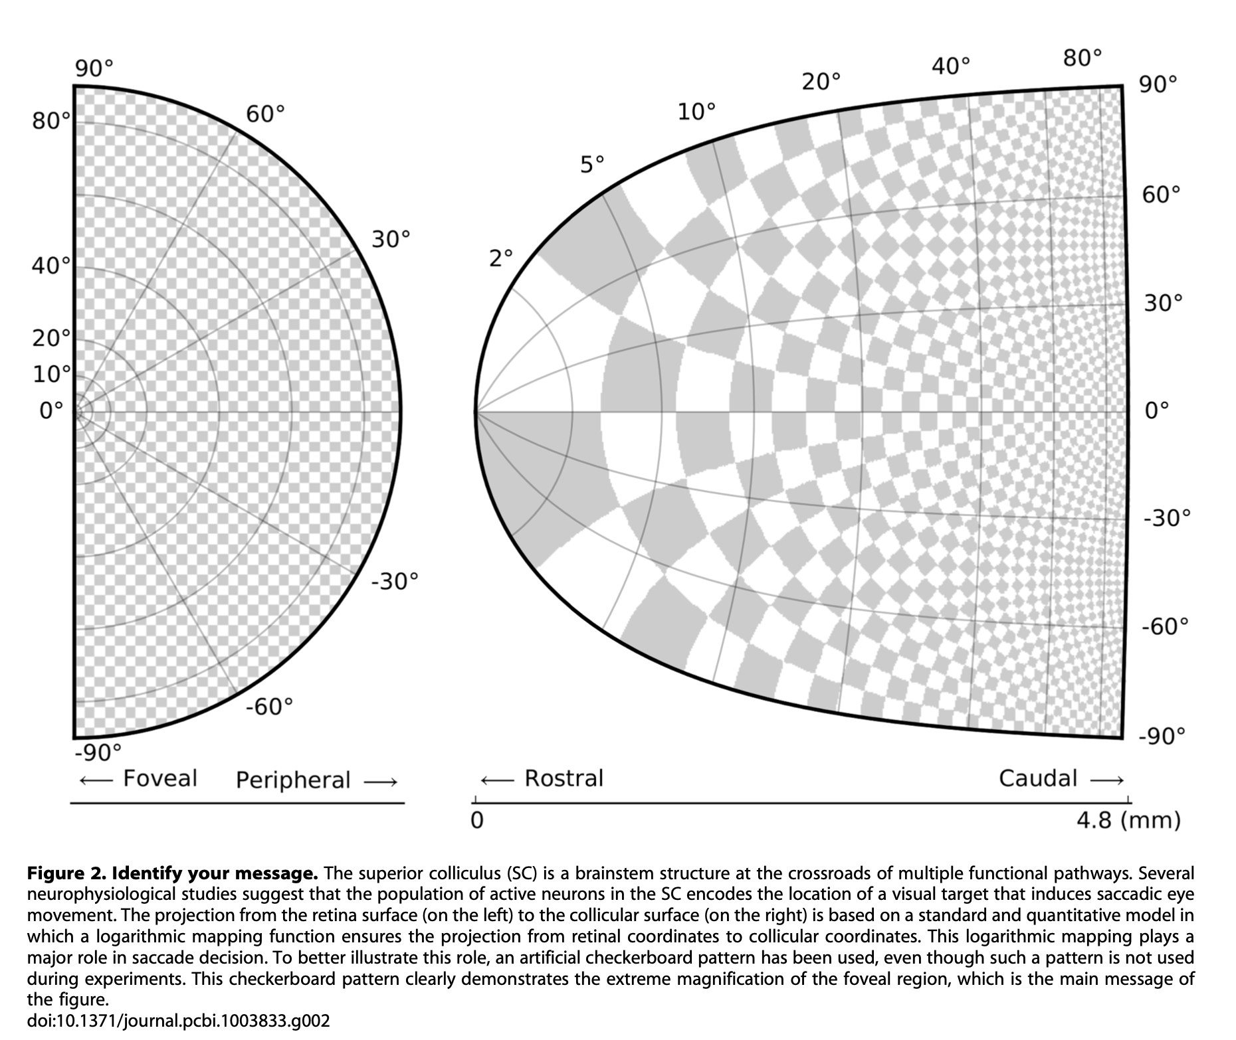
What is the message for my figure?
It helps to decide the figure message before you begin designing
A picture is worth 1000 words—imagine trying to describe this in writing ☹

Slide 26
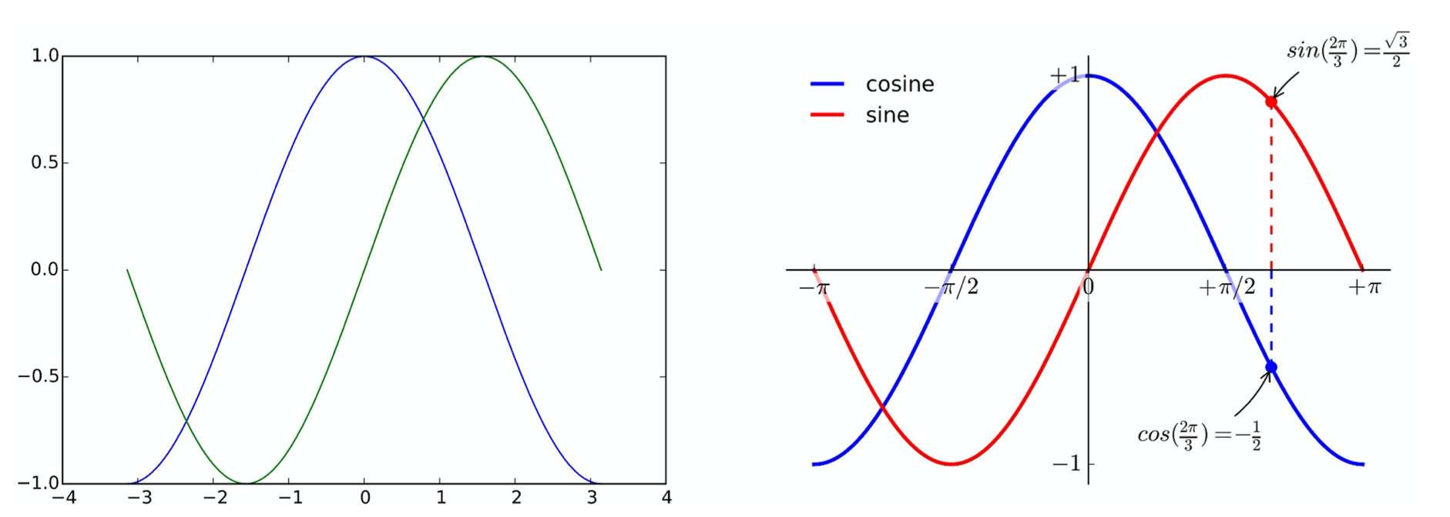
“Technical” rules for good figures
Which figure is more clear and why?
Rule: Do not trust the default settings.
Produced using Matplotlib, which defaults font size, legend, line size and color, etc.

Slide 27
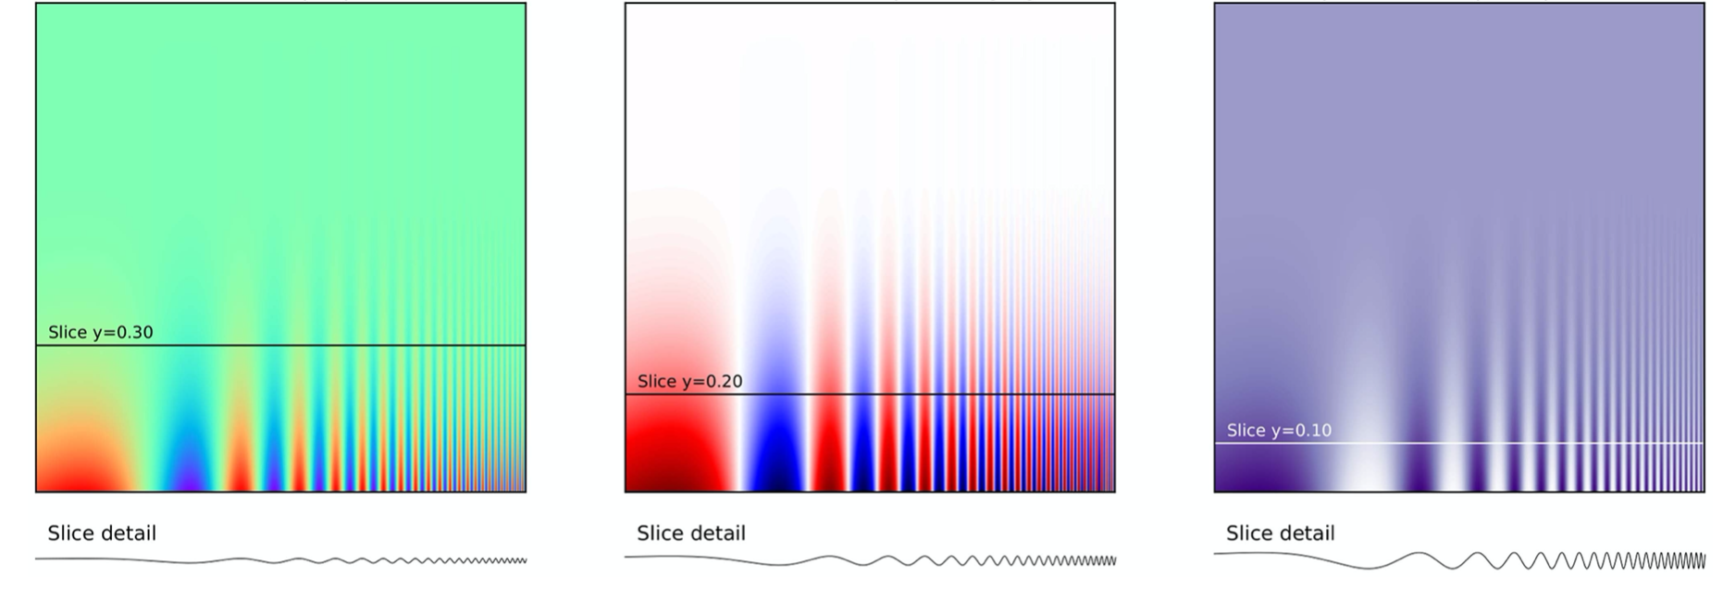
“Technical” rules for good figures
All 3 figures show the same thing, but which panel shows the data most clearly?
Rule: Use color effectively.
One dataset only needs one color
Colors must serve a purpose to make your data more easily understood, not for aesthetics; unnecessary coloring just causes confusion
Be aware of color-blindness (especially red-green)

Slide 28
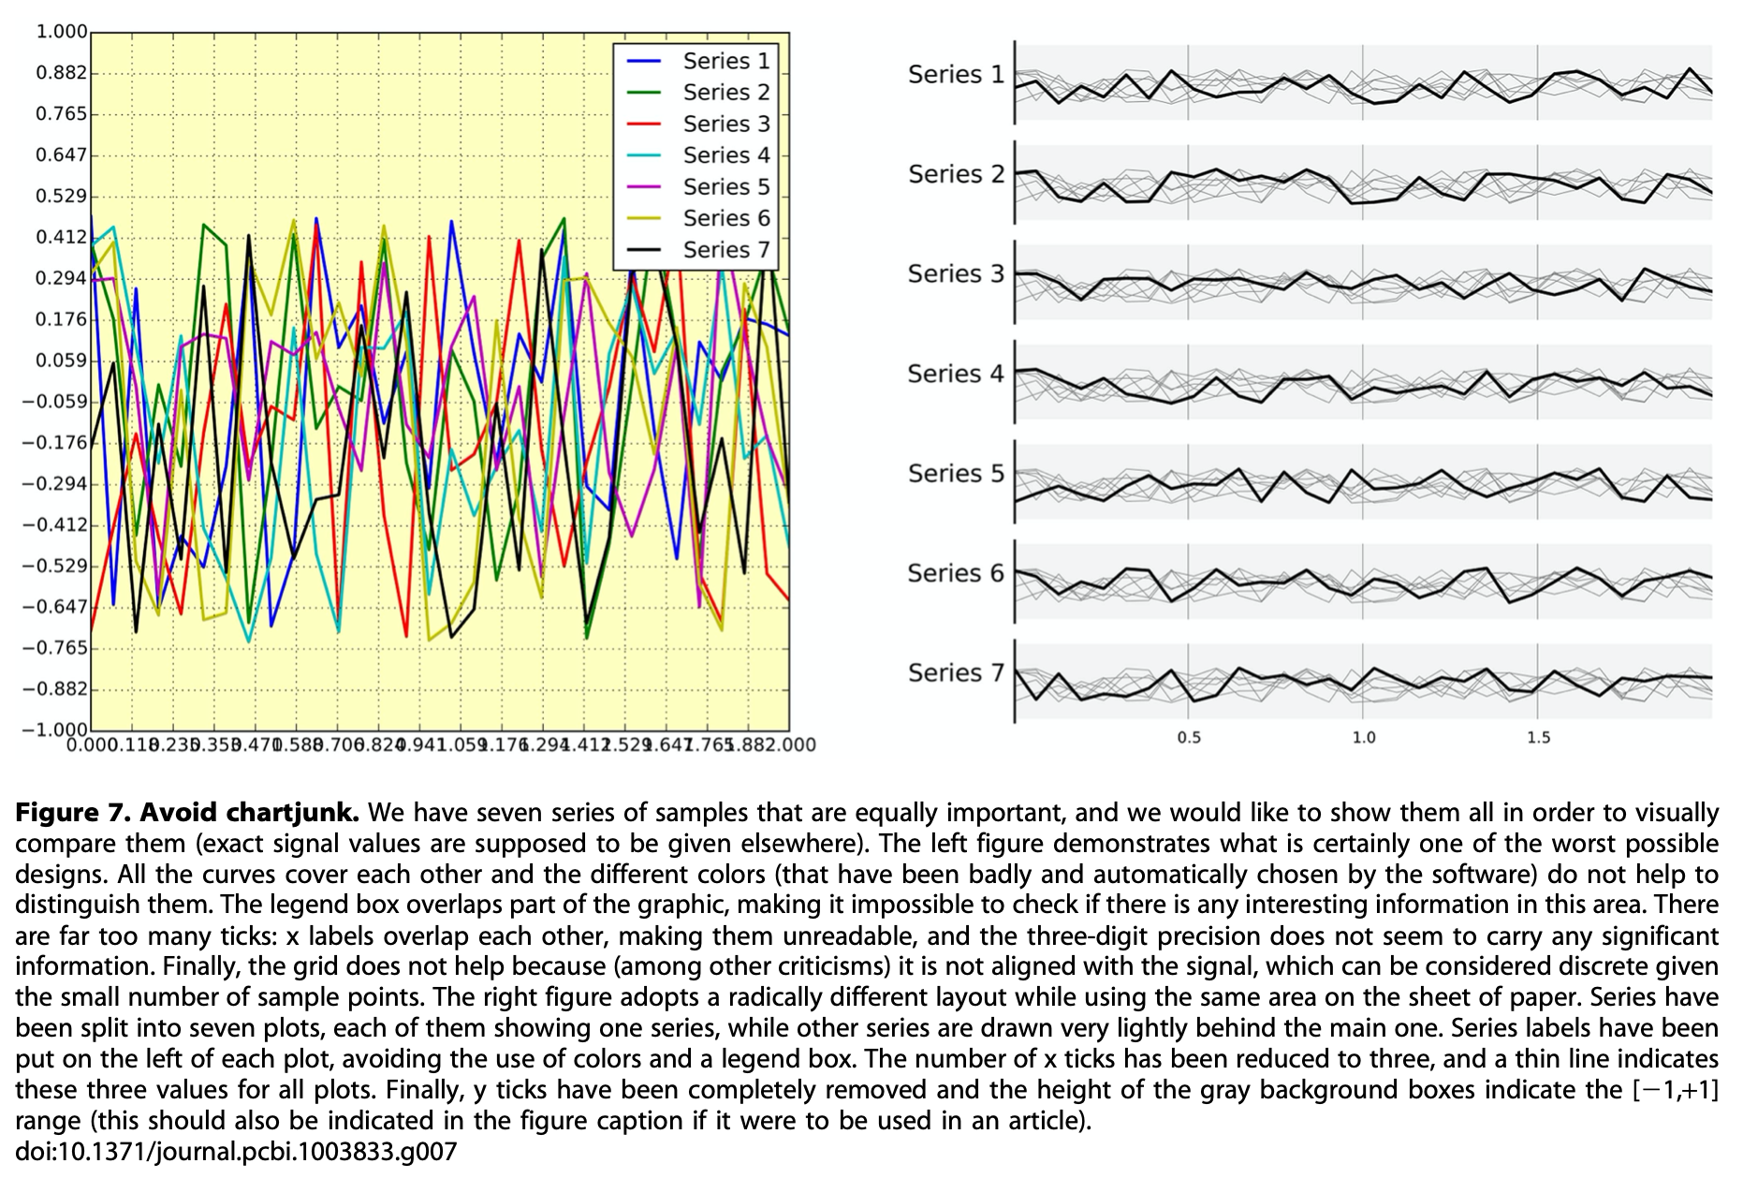
“Technical” rules for good figures
What is wrong with this figure?
Overlapping chaos
Legend covers data
Too many ticks on axes
Background color and grid
…
How would you fix it?
Rule: Avoid chart junk
Always ask if an element is necessary
Includes colors, background, number of ticks, etc.

Slide 29
Captions are not optional
The figure and caption should stand on their own
Anybody should be able to understand the data without reading the rest of the paper
There’s no shame in a long caption as long as it’s necessary to explain the figure.

Slide 30
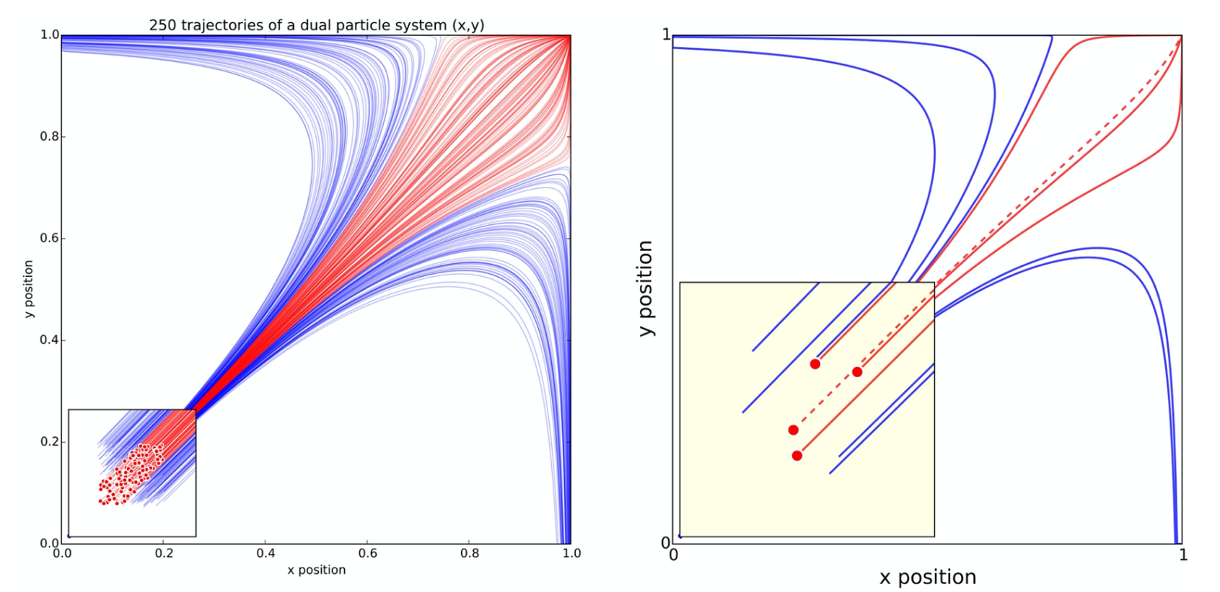
Adapt the figure to the setting
How long does will somebody be looking at this?
Talks (<1 minute per slide)
Papers (all the time they need)
Which one would you prefer for a talk vs. a paper?

Slide 31
Which software(s) should I use to make figures?
First, always check with the journal, there are probably rules already in place for this.
Plotting
Matplotlib (Python)/R: good if you have some prior experience
GraphPad Prism: great for all things biostatistics-related
Excel: not preferred for publication, but good to make starting figures
Graphics:
Inkscape: good for introductory schematics
BioRender (anything biology-related)
*References/links on last slide

Slide 32
Time to look at your figures/captions
Is the message clear?
If I found this figure laying on the floor, would I be able to understand it?

Slide 33
Resources for writing at VU
Vanderbilt Writing Studio
BRET office hours
YouTube
Judy Swan (Science writing guru)
Mock NIH study sections
Your colleagues! Fellow grad students, post-docs, even your PI

Slide 34
References/links
Matplotlib (https://matplotlib.org/)
R (https://www.r-project.org/)
GraphPad Prism (https://www.graphpad.com/scientific-software/prism/)
Excel (https://www.microsoft.com/en-us/microsoft-365/excel)
Inkscape (https://inkscape.org/)
BioRender (https://biorender.com/)

Slide 35
One last thing…
Grad school is stressful…
Quals are stressful…
Covid is stressful…
University Counseling Center
Stacey Satchell
Coworkers, classmates, PIs

